Slide 1
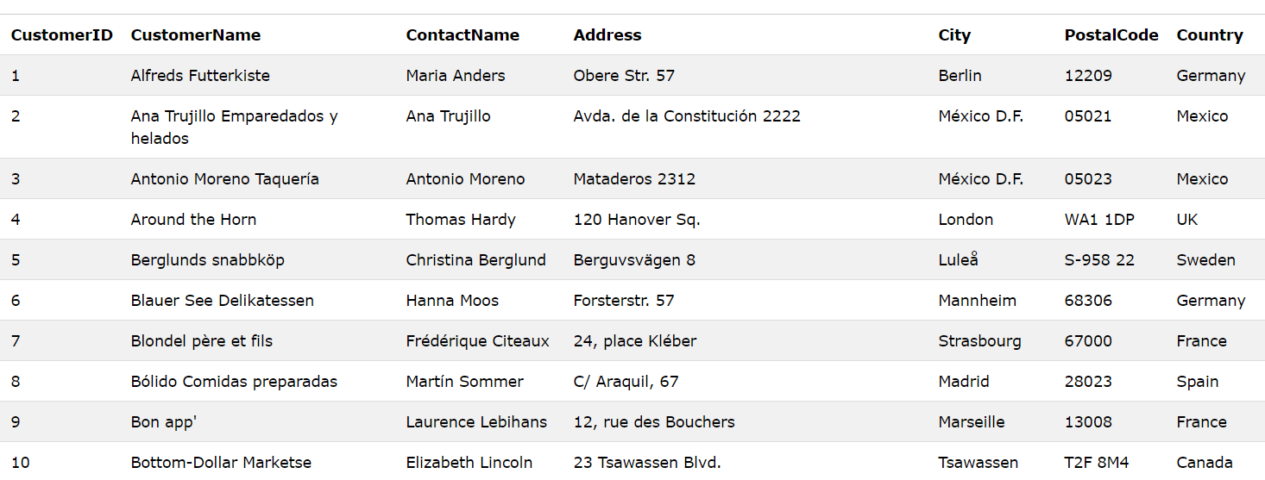
The Database

Slide 2
Query is just an SQL Statement
Fetch
Manipulate
Create
SELECT ...

